Slide 1
Notes:
[Blank??] Bought a Sinar camera … did experiments ….

Slide 2
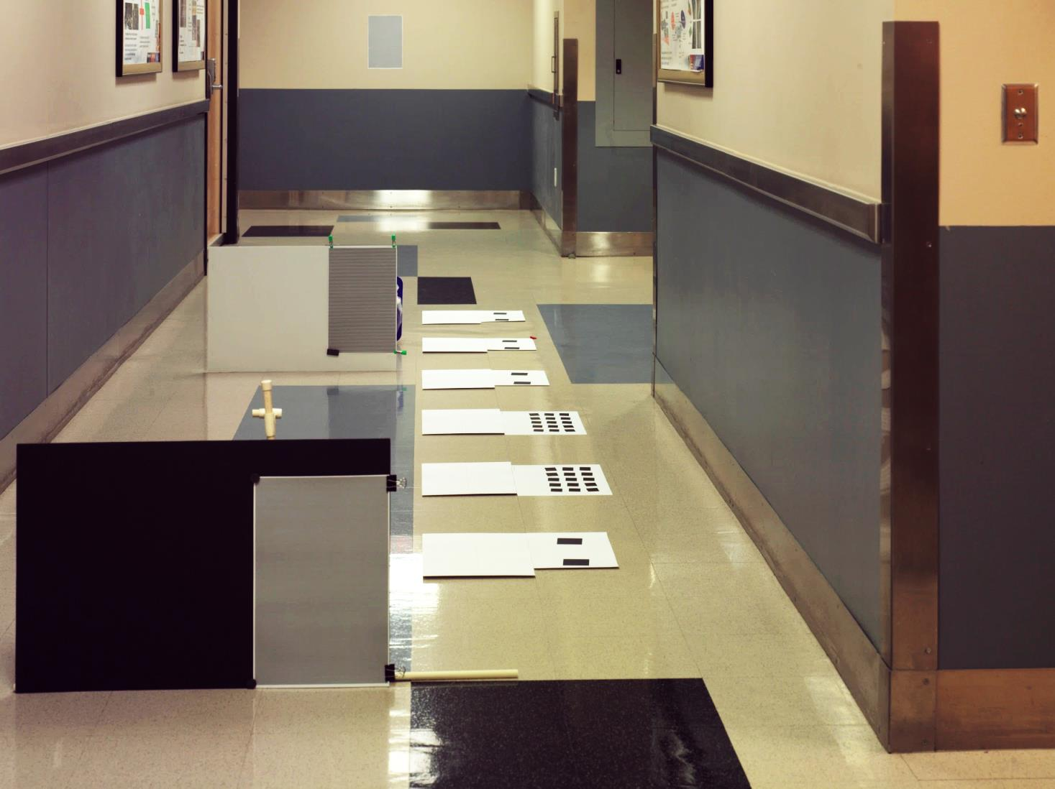

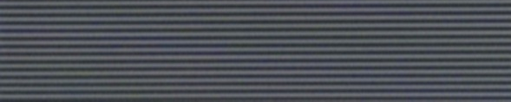

1
1
0.25 lp/mm
1.58 m
2
40 pixels across
13 line pairs
=> 45.14 lp/mm
2
8.1 m
0.5 lp/mm
Plane of Focus
4.1 m
3
3
1 lp/mm
4.1 m

Slide 3
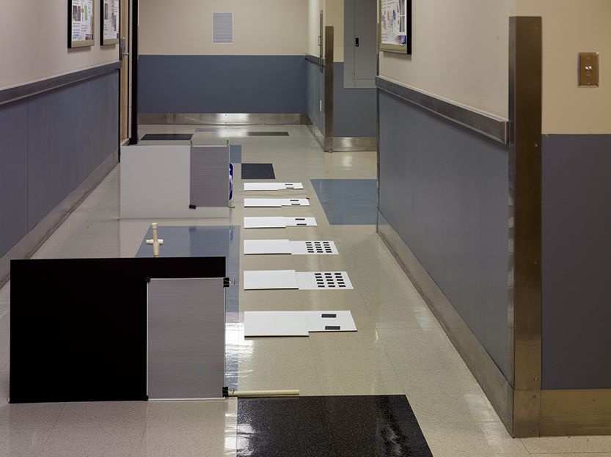

1
1
0.25 lp/mm
1.58 m
2
2
8.1 m
0.5 lp/mm
3
3
40 pixels across
13 line pairs
=> 45.14 lp/mm
Plane of Focus
4
4.1 m
1 lp/mm
4
5
5
4.1 m

Slide 4
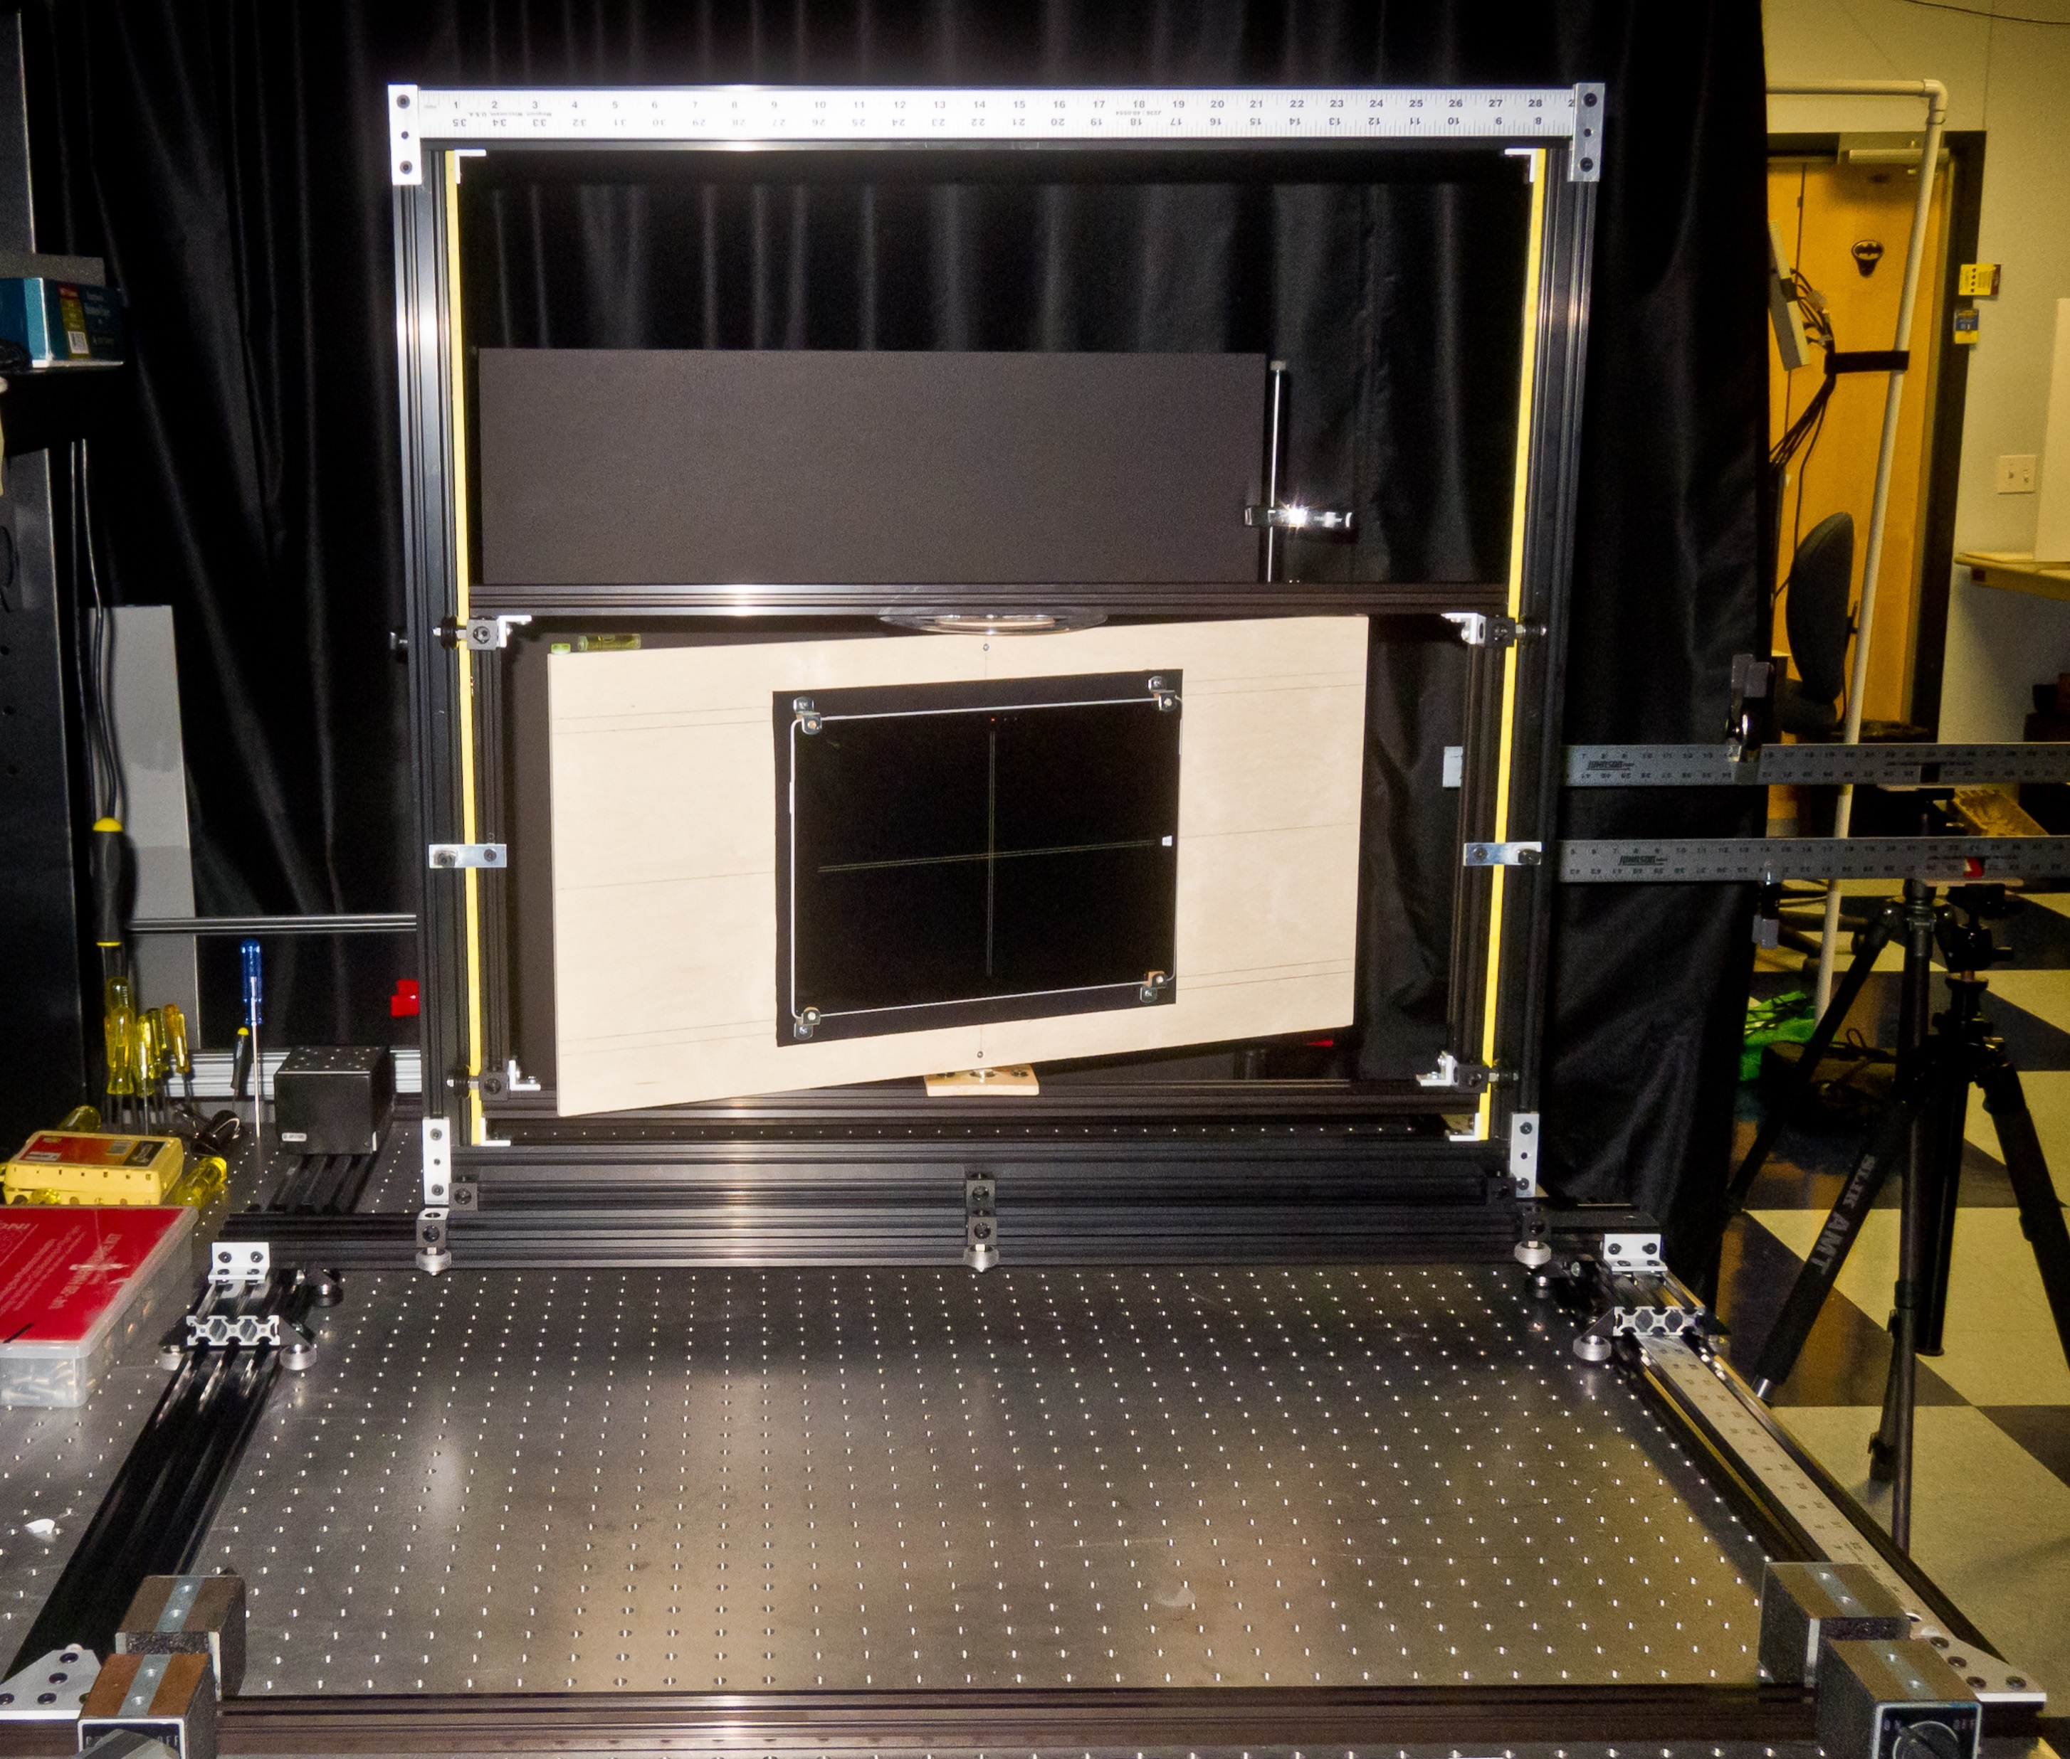
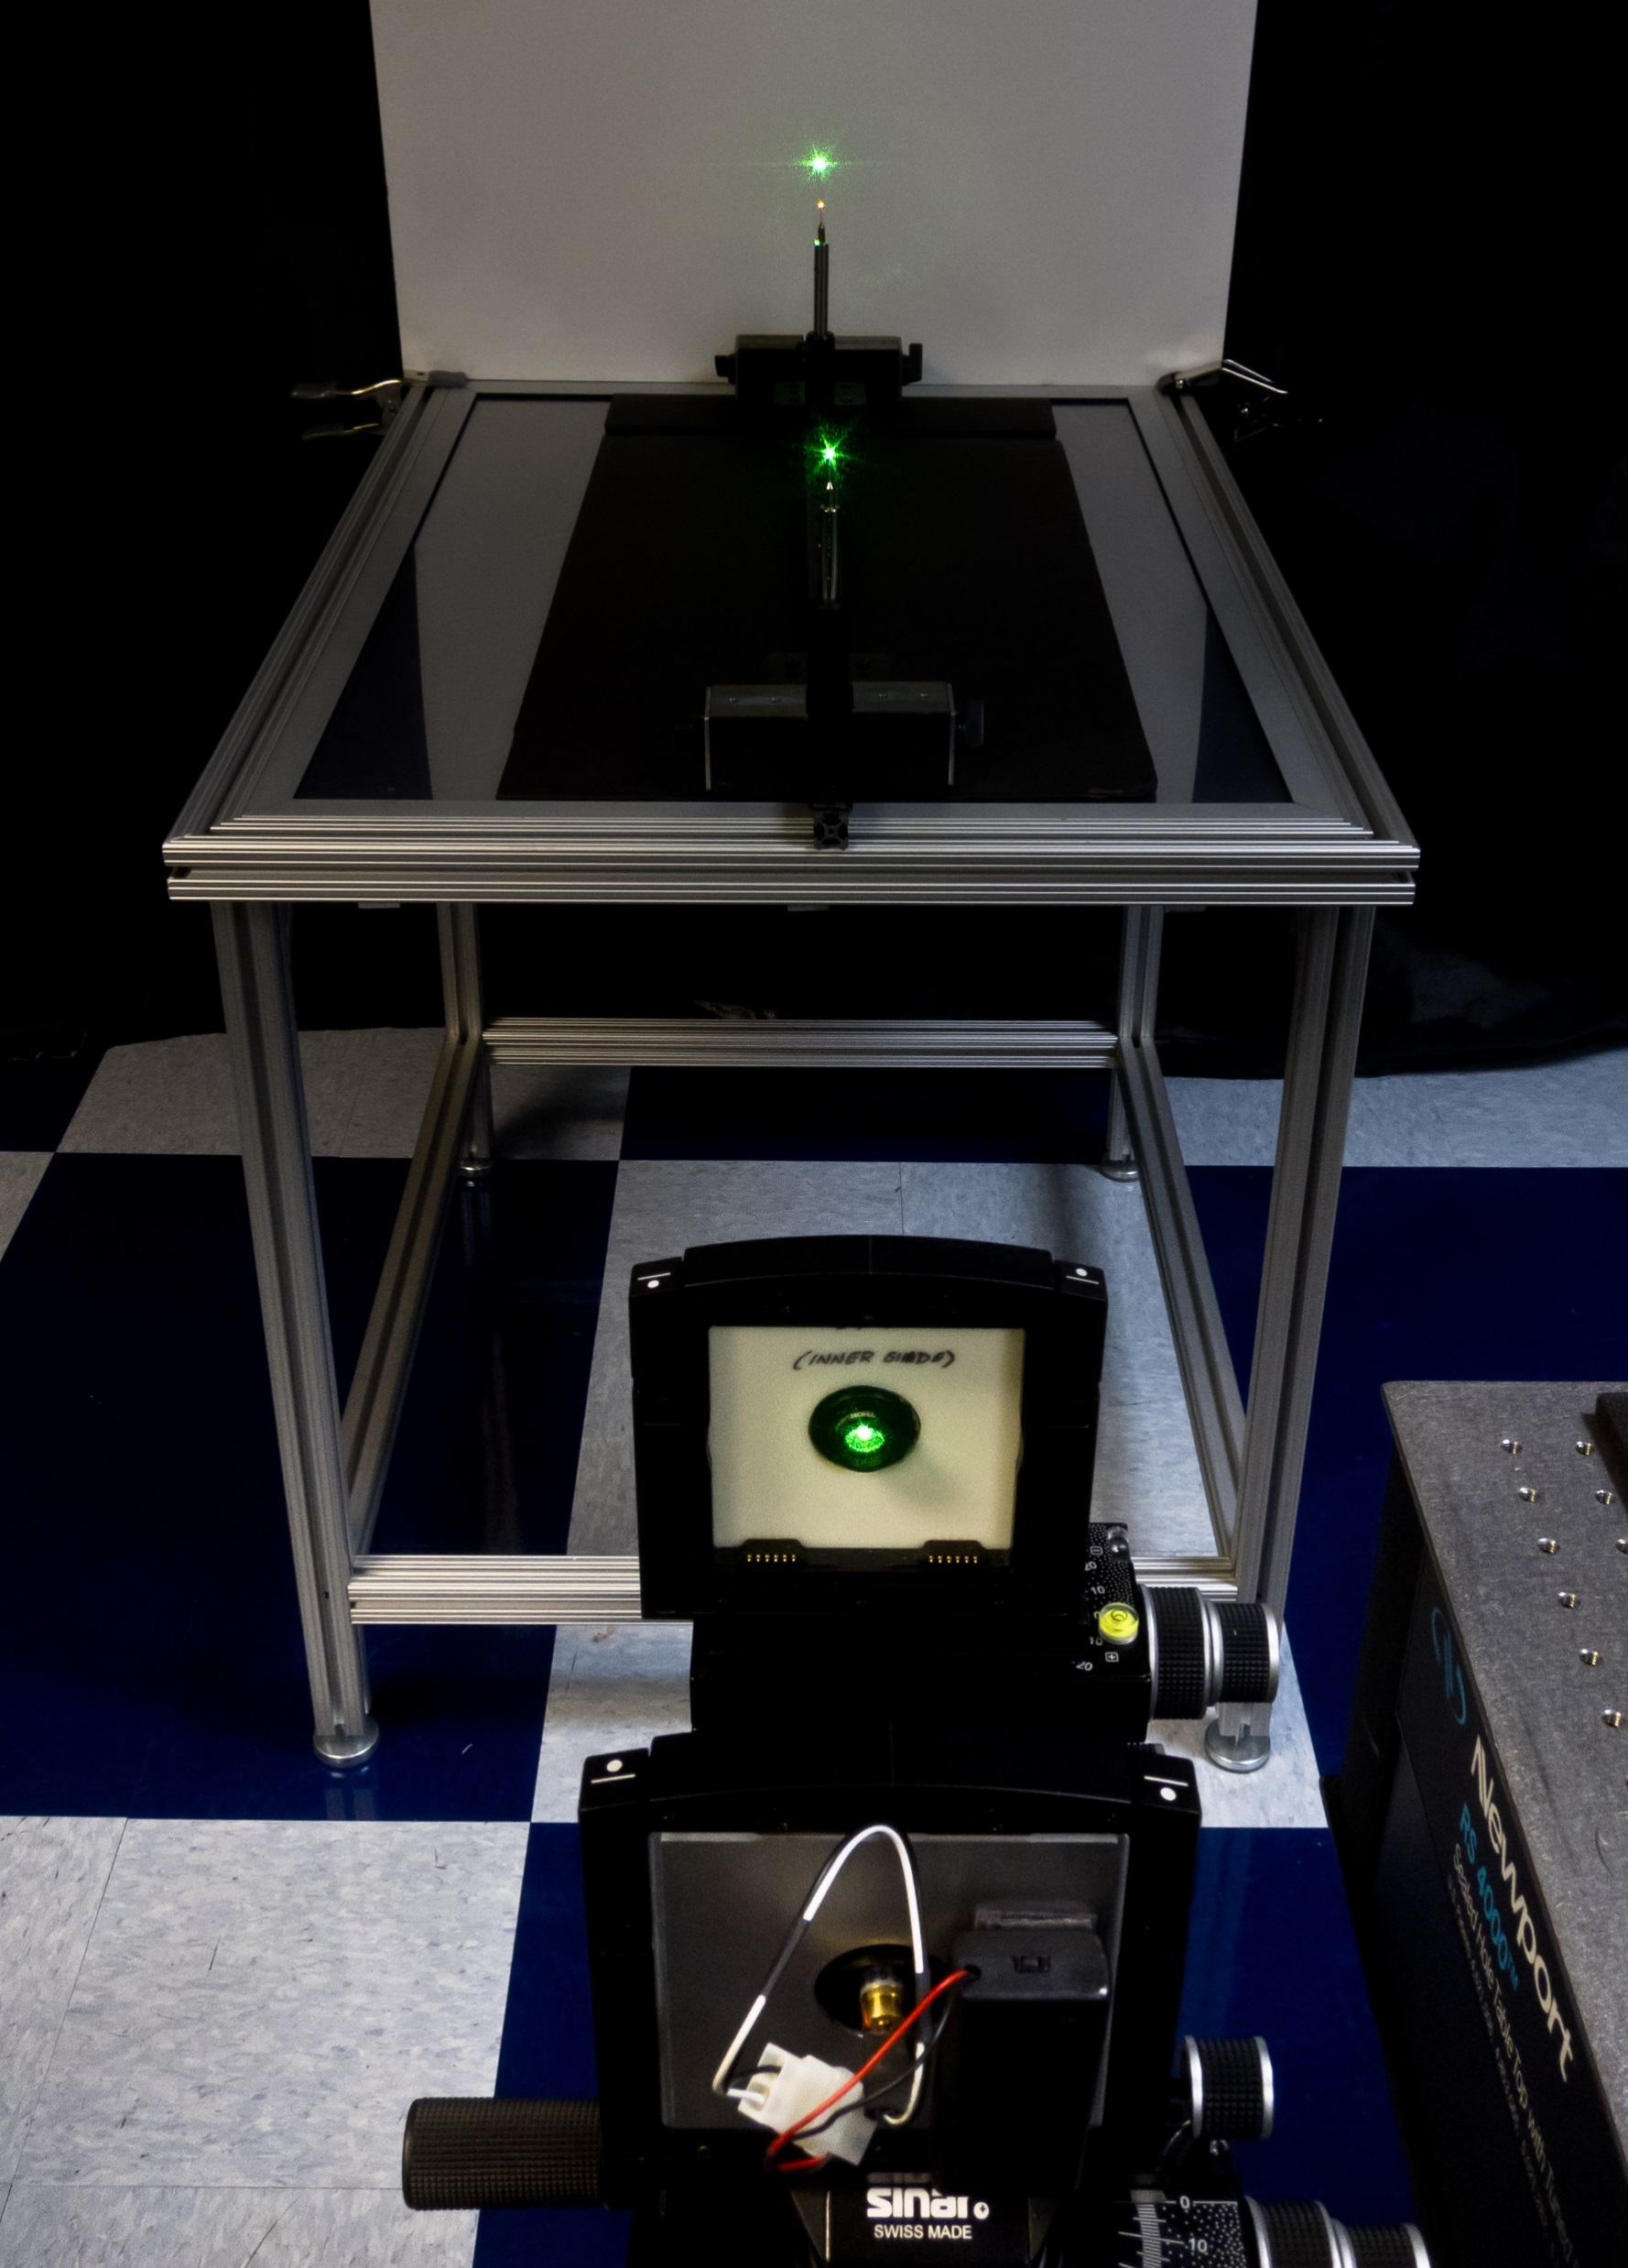
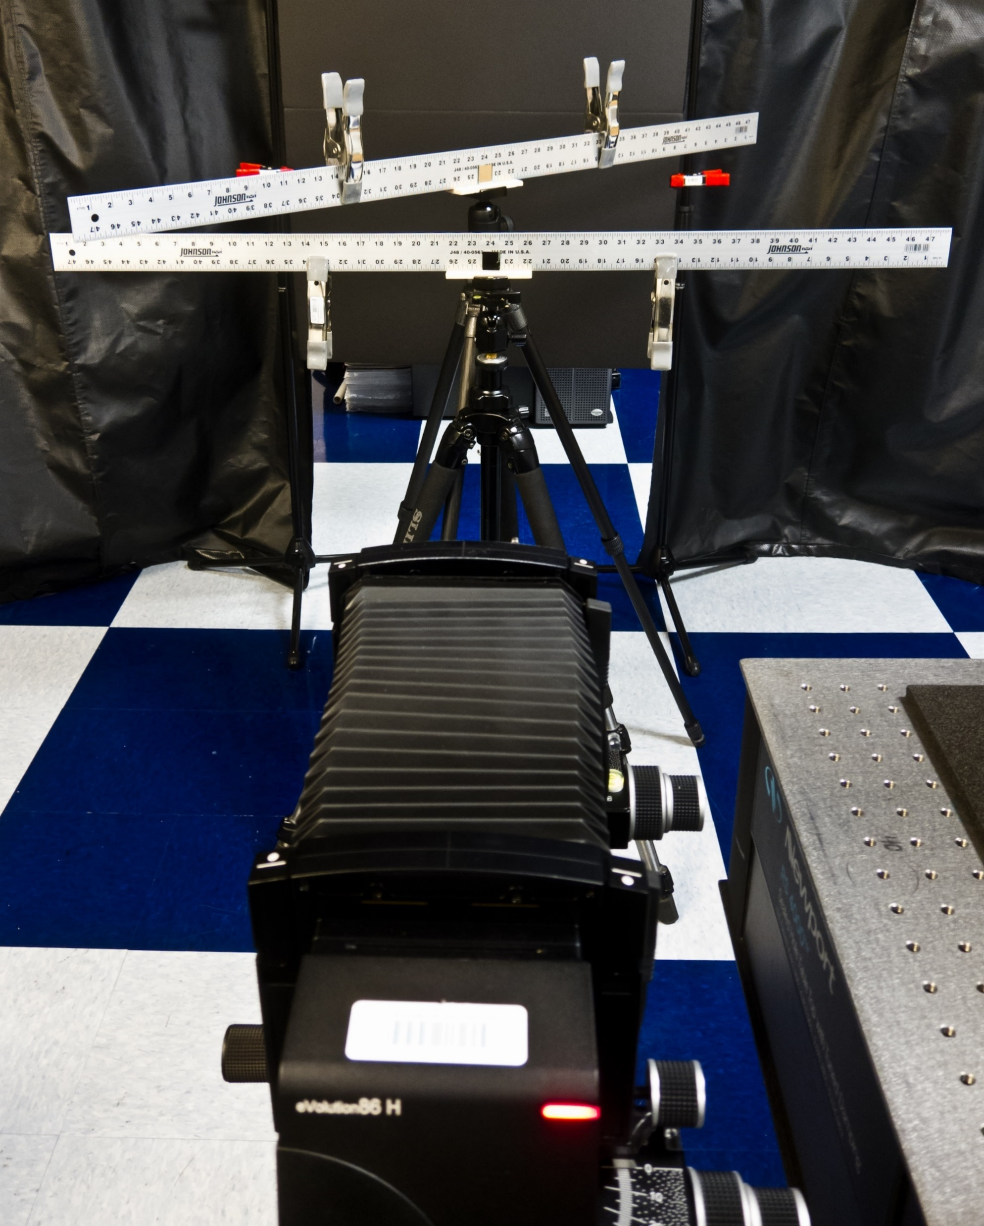

Slide 5
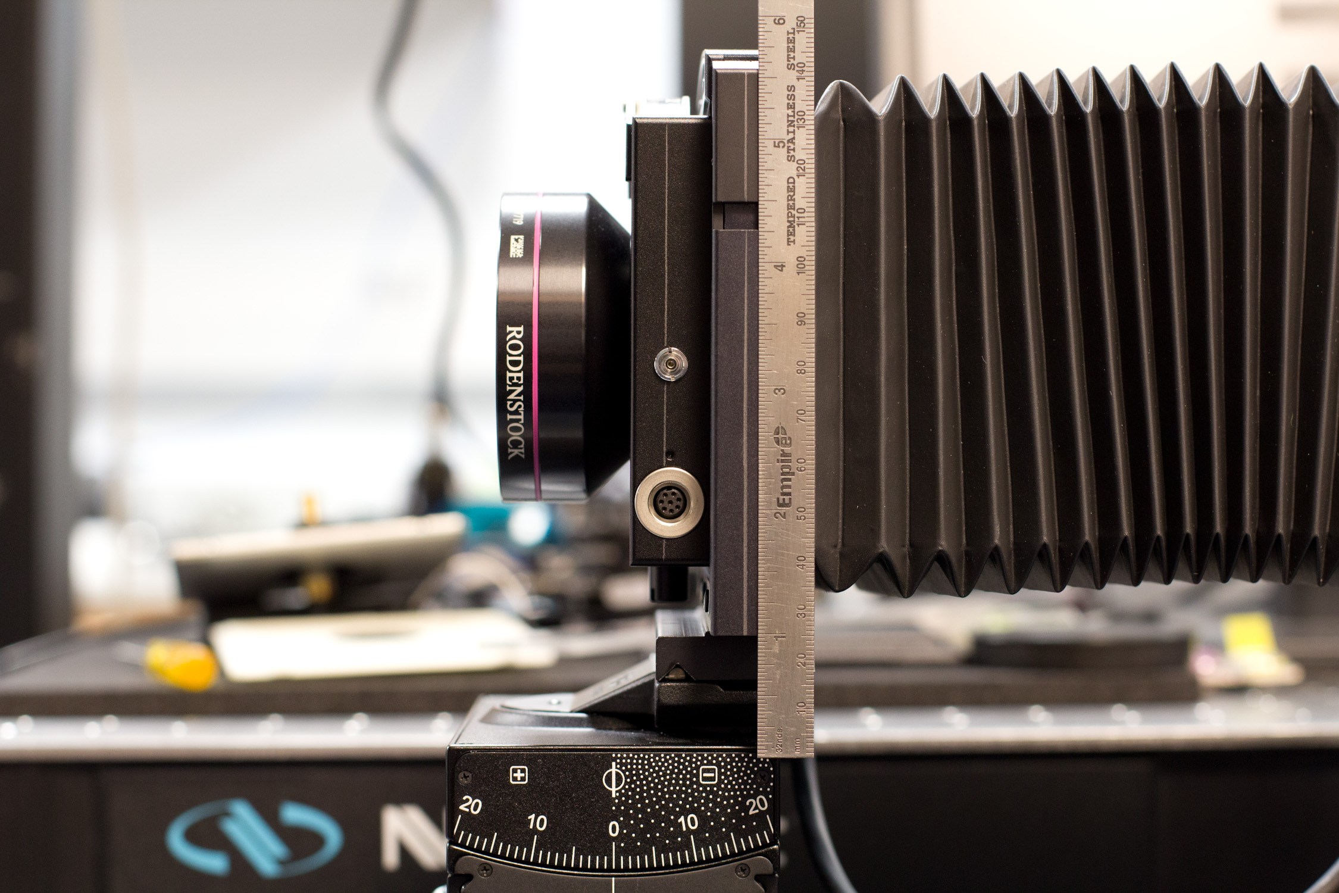
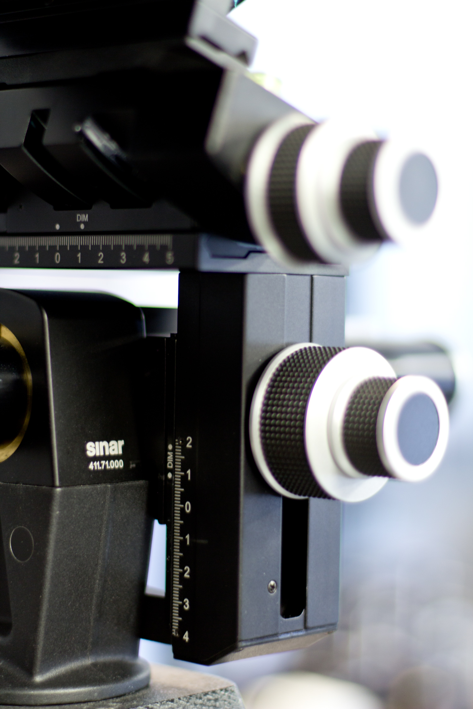
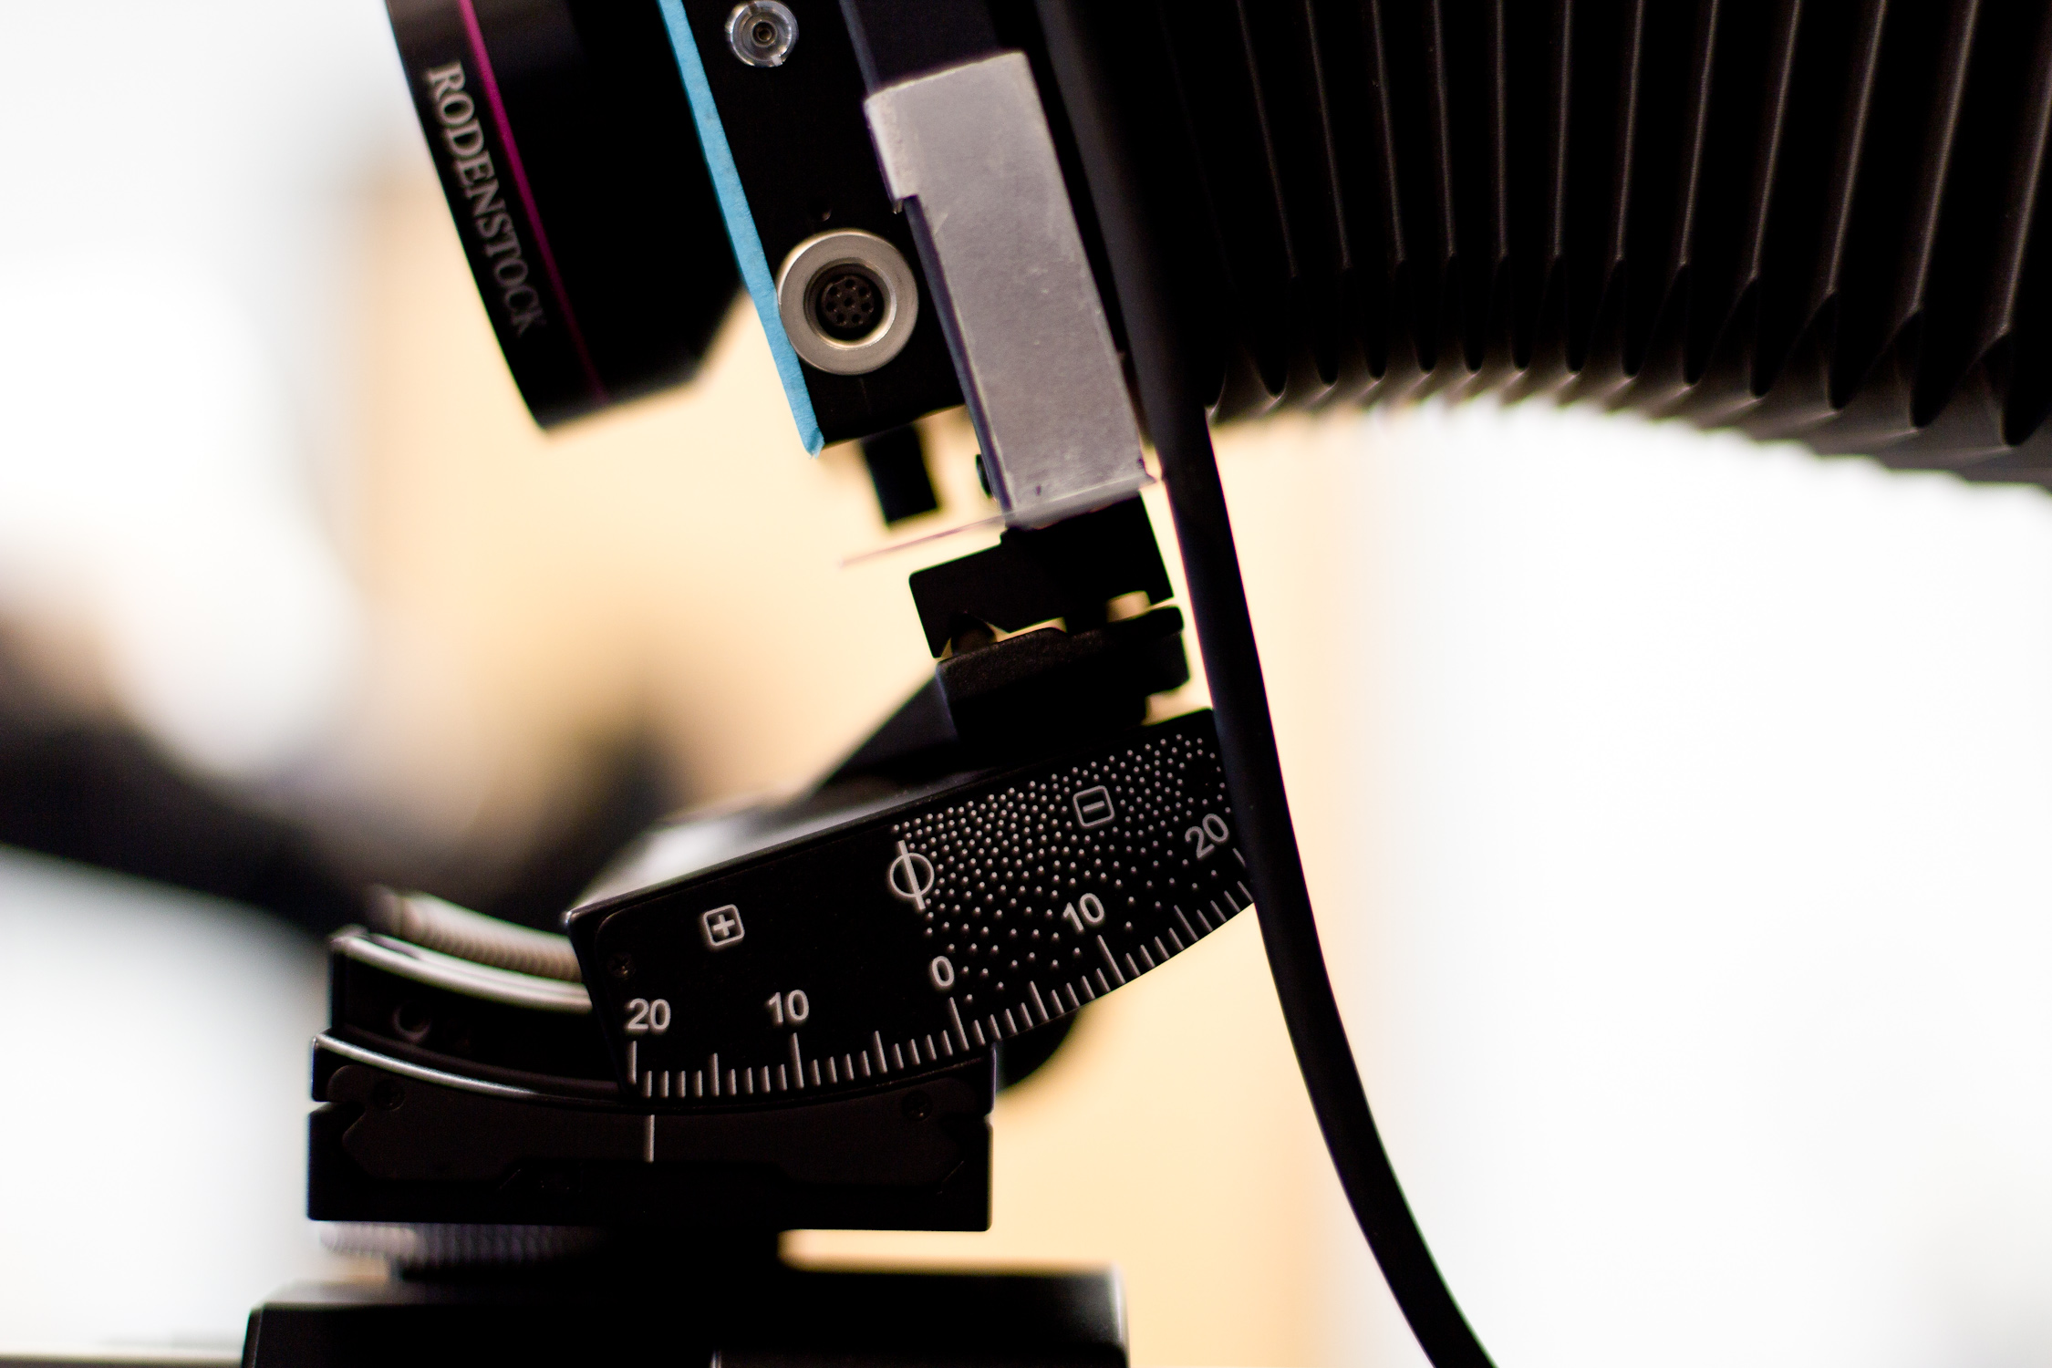
Center of entrance pupil
Optical axis
10 mm
32 mm
Lens pivot
Notes:
Problems ….
….From prior experience while setting up experiments for optical super-resolution in the lab, we attributed this distortion of the image to fact that the lens was not necessarily rotating about the center of the entrance pupil. Now, I haven’t explained what the entrance pupil is yet, so what is the center of the entrance pupil? Well, we will get to that in a minute. But for now, let me just say that we found this point … as shown in the figure. But, the lens in our camera always rotated about a different point. Therefore, every time we tilted the lens, the center of the entrance pupil would shift, and we had to do some adjustments—translations along the vertical and axial directions—to restore the position of the entrance pupil.
….but even when we rotated about the entrance pupil, we were observing a small shift of the image field. At that time, we weren’t really expecting this. In my prior experience during optical superresolution experiments in the lab, w The problem was we were never certain whether it was due to adjustment errors or it was for real.
…

Slide 6
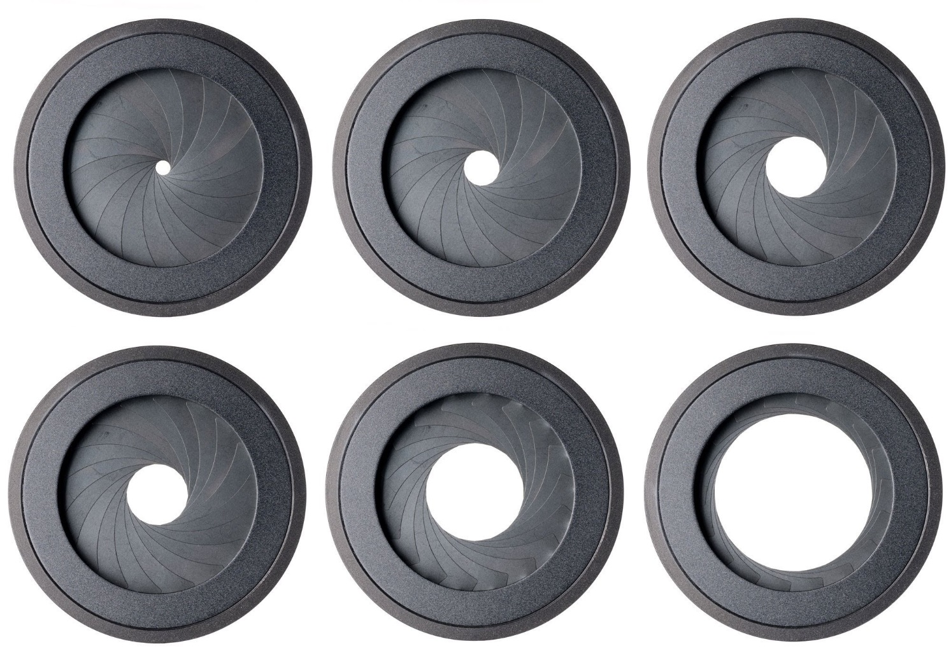
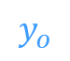


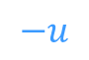
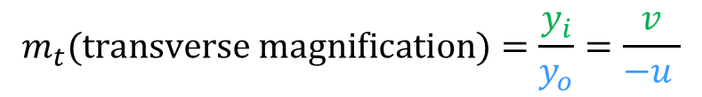

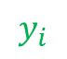
Chief rays from the object space to the image space defines the image shape
Aperture (stop)
Image plane
Object
$$\text{x}$$
Chief ray
$$y_{o}$$
Optical axis
$$y_{i}$$
$$−u$$
$$v$$
Image
$$\acute{\text{x}}$$
Use of similar triangles:
$$m_{t}\text{(}\text{transverse} \text{magnification}\text{)}=\frac{y_{i}}{y_{o}}=\frac{v}{−u }$$
1
Notes:
The chief ray is the ray from the object point to the image point that passes through the center of the aperture. As seen in the figure, the intersection of the chief ray with the image plane determines the height of the image point. Therefore, for an extended object that consists of a set of points, the set of chief rays from the object space to the image plane determines the geometric properties of the image. We can find all relationships by applying similar triangles.
Furthermore, since all chief rays

Slide 7
Center of perspective: the chief rays from the object space converge at the center of the aperture
Aperture
Image plane
Chief rays
Object
Object
Image
Chief rays
Aperture
Image plane
Image
Notes:
The chief ray is the ray from the object point to the image point that passes through the center of the aperture. As seen in the figure, the intersection of the chief ray with the image plane determines the height of the image point. Therefore, for an extended object that consists of a set of points, the set of chief rays from the object space to the image plane determines the geometric properties of the image. We can find all relationships by applying similar triangles.
Furthermore, since the chief rays from the object converge at the center of the aperture, the center of the aperture is the “center of perspective projection” … in other words, if we change the location of the aperture’s center, a different set of rays from the object becomes the chief rays, and we

Slide 8
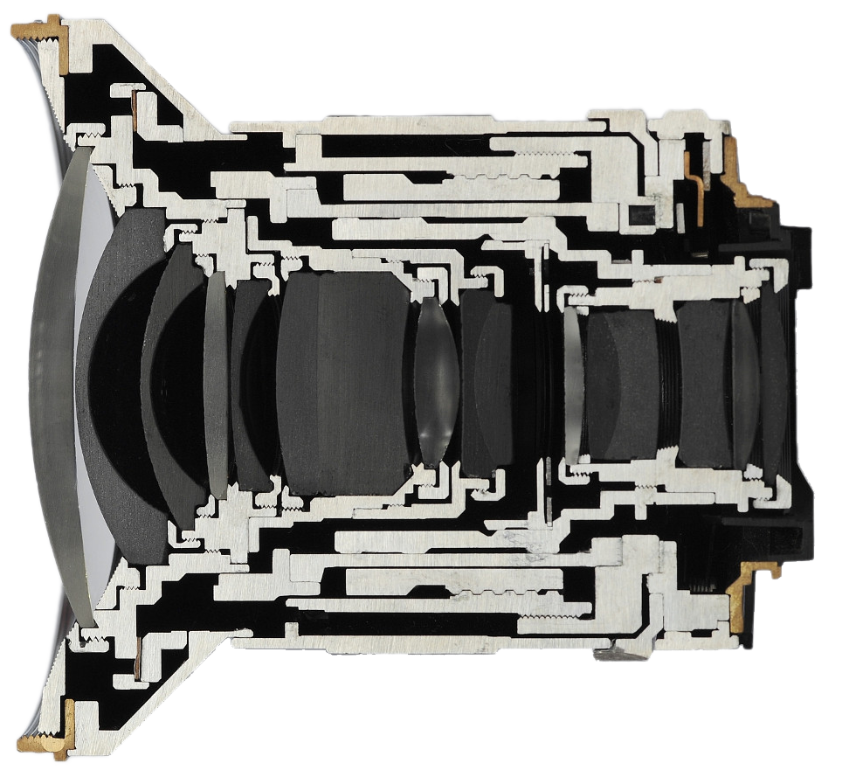
Real lenses have several refracting surfaces on either side of the aperture (stop)
Lens elements
in front of the aperture
Lens elements behind the aperture
Aperture
Cross-section of Zeiss Distagon 21mm F/2.8
[Photograph from ilovehatephoto.com]

Slide 9
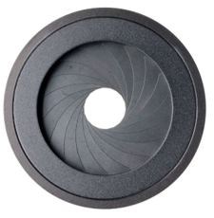
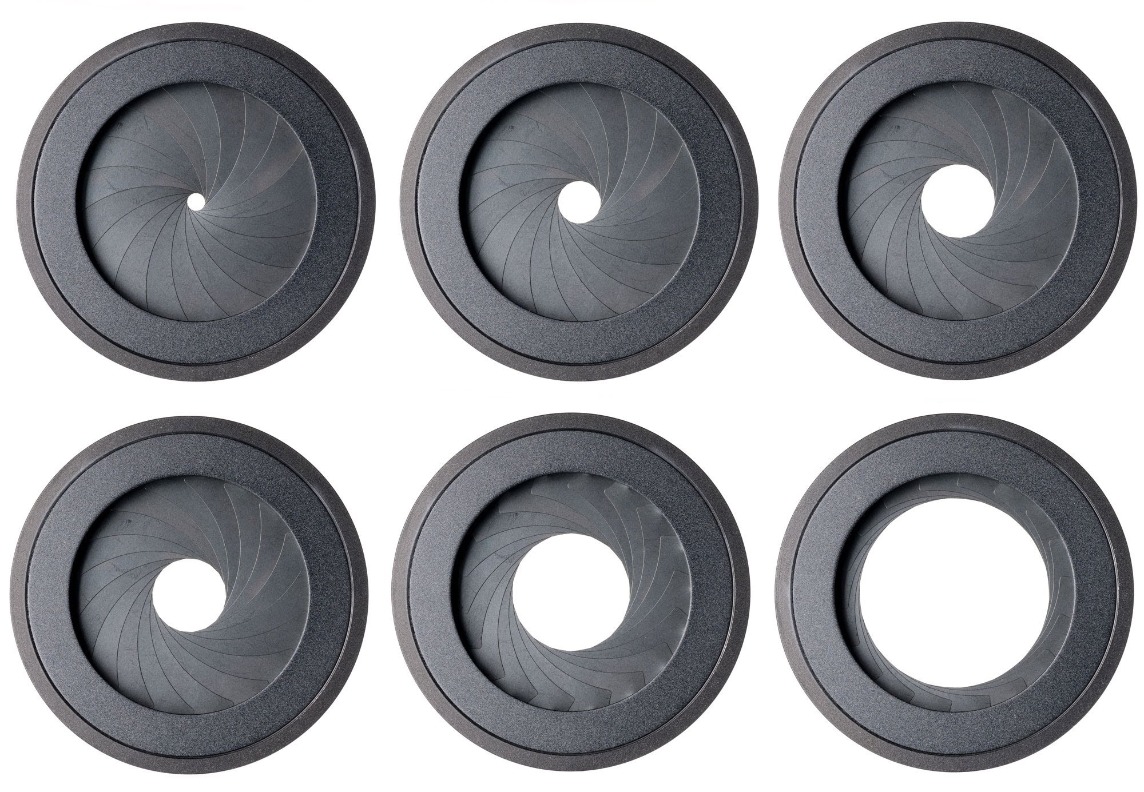
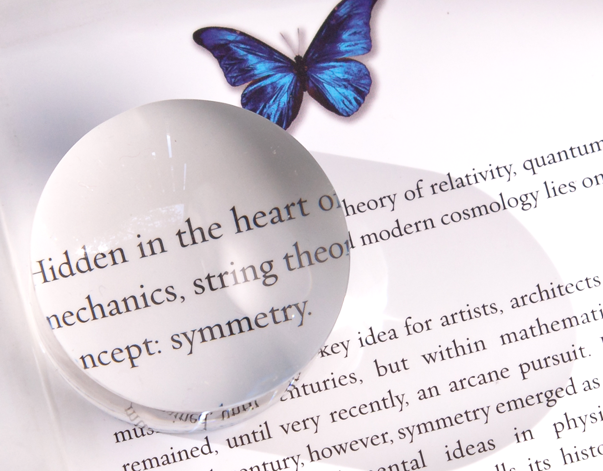
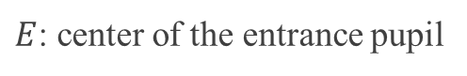
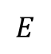
xxxxxxx
Front view
+
Side view
$$E$$
Marginal ray
Aperture
Entrance pupil
$E$: center of the entrance pupil
Notes:
When we hold a magnifying glass over some text, the text looks magnified. Most of us will remember, the lens forms a virtual and enlarged image of the text behind the text. Similarly, when we place refracting elements in front of the aperture, we usually see a magnified image of the physical stop that is located behind the physical stop.
In the same way, when the chief rays from the

Slide 10
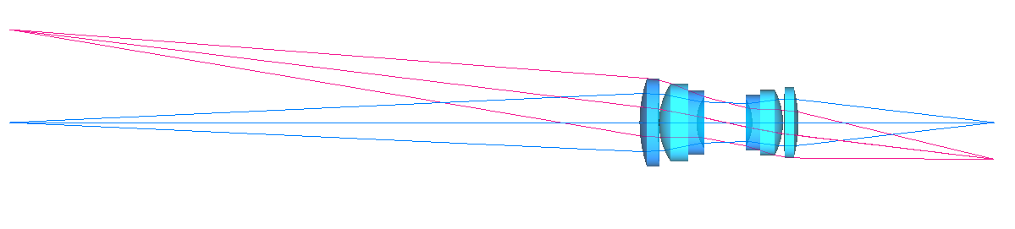
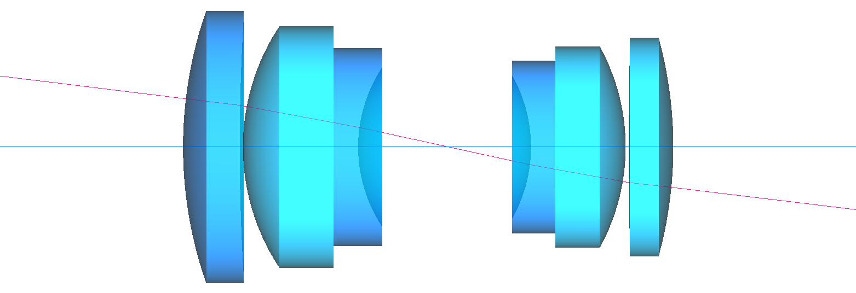
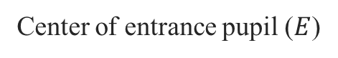
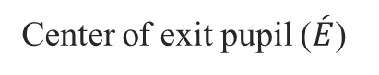
The “entrance pupil” is the image of the stop formed by the front lens elements
and the “exit pupil” is the image of the stop formed by the rear lens elements
Chief ray
Aperture (stop)
Object
Chief ray
Image
~361 mm
~144 mm
A double gauss lens (f = 102 mm) ▴
Exit pupil
Entrance pupil
Chief ray
Stop
Center of entrance pupil ($E$)
Center of exit pupil ($\acute{E}$)
Notes:
Here is a widely popular lens design called the Double Gauss, with a few rays traced from the two extreme points of an object. The image shows the chief rays, the marginal rays, and the lens consisting of refracting elements in front and behind the aperture.
The zoomed in figure shows the location of the entrance pupil, which is the image of the aperture formed due to the lens elements on the object side, and the exit pupil, which is the image of the aperture formed due to the lens elements on the image side. I found the locations and the size of the images using Zemax.
Furthermore, if we concentrate on the chief rays, we can see that the chief rays from the object side entering the lens appear to converge towards the center of the entrance pupil, and the corresponding chief rays going away from the lens towards the image plane, appear to diverge from the center of the exit pupil.
Now, because the angle of the chief ray going towards the image plane will determine the height—and therefore the geometric properties—of the image, a question to ask is whether the chief ray entering the lens and and the corresponding chief ray exiting the lens are parallel?

Slide 11
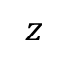

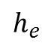
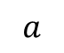
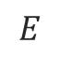
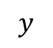

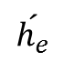
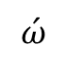
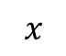
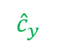
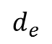
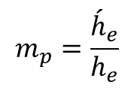
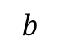
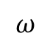
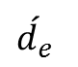
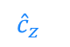
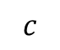


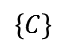
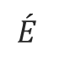
Nothing in optics makes sense except in the light of the pupils
Exit pupil
Entrance pupil
Chief ray (input)
$$h_{e}$$
$$\acute{h_{e}}$$
$$\text{x}$$
$$l$$
$${\hat{c}}_{y}$$
$$ω$$
$$E$$
$$\left\{C\right\}$$
$$\acute{E}$$
Optical axis
$${\hat{c}}_{z}$$
$$\acute{ω}$$
$$\acute{l}$$
Chief ray (output)
Lens pivot & origin of camera coordinate frame
$$d_{e}$$
$$\acute{d_{e}}$$
$$z$$
Pupil magnification:
$$c$$
Direction cosine
$$b$$
$$m_{p}=\frac{{\acute{h}}_{e}}{h_{e}}$$
$$y$$
2
$$a$$
$$l= <\cos{a},\cos{b},\cos{c}>$$
$$x$$
Notes:
But before we get there, lets introduce … how w
Talk about the abstraction of lens, and the pupil magnification.

Slide 12
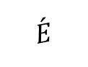
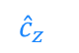
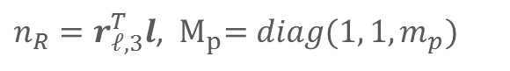
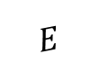

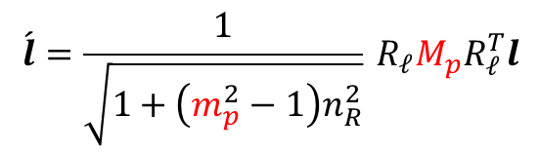
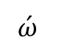

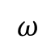
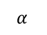

The pupil magnification $m_{p}$ changes the chief ray’s direction cosine
in the image space
Exit pupil
Entrance pupil
Chief ray
$$\text{x}$$
$${\hat{c}}_{y}$$
$$l$$
$$\acute{E}$$
$$\left\{C\right\}$$
$$\acute{ω}$$
$$α_{ }$$
$$ω$$
$${\hat{c}}_{z}$$
$$E$$
Optical axis
$$\acute{l}$$
Lens pivot & origin of camera coordinate frame
$$\acute{l}=\frac{1}{\sqrt{1+\left(m_{p}^{2}−1\right)n_{R}^{2}}}{}_{ }^{ }{R_{𝓁}}M_{p}R_{𝓁}^{T}l$$
Chief ray’s direction cosine at the input (object space)
Chief ray’s direction cosine at the output (image space)
3
$n_{R}=r_{𝓁,3}^{T}l$, ${ M}_{p}=diag(1, 1, m_{p})$
Notes:
The first step in bu
.. The pivot of the lens is the center of the camera coordinate system
Notice that the output direction cosine of the chief ray is unmodified if the pupil magnification is unity.

Slide 13




















Image-object relationship for arbitrarily oriented lens and sensor rotations
Exit pupil
$${\hat{n}}_{i}$$
Chief ray
Pivots
Entrance pupil
$$\text{x}$$
$${\hat{c}}_{y}$$
$$\acute{E}$$
$${\hat{i}}_{y}$$
$$l$$
$${\hat{i}}_{x}$$
$$\left\{C\right\}$$
$$\acute{ω}$$
$$α_{ }$$
$$ω$$
$${\hat{c}}_{z}$$
$$\left\{I\right\}$$
$$E$$
$$\acute{l}$$
Optical axis
$$\acute{\text{x}}$$
$${\acute{d}}_{e}^{ }$$
$$d_{e}$$
$${\acute{z}}_{o}^{ }$$
Image plane
$$\begin{aligned}{}_{ }^{I}{\acute{\text{x}}}=&{R_{i}}^{T}\left({\acute{d}}_{e} r_{𝓁,3}−t_{i}\right)+\frac{\left({\hat{n}}_{i}\left(3\right){\acute{z}}_{o}−{\acute{d}}_{e}{\hat{n}}_{i}^{T} r_{𝓁,3}\right)}{{\hat{n}}_{i}^{T}R_{𝓁}M_{p}R_{𝓁}^{T}\left({}_{ }^{c}{\text{x}}−d_{e} r_{𝓁,3}\right)}{}_{ }^{ }{{R_{i}}^{T}R_{𝓁}}M_{p}R_{𝓁}^{T}\left({}_{ }^{c}{\text{x}}−d_{e} r_{𝓁,3}\right)\end{aligned}$$
4
Coordinates of image point in image reference frame
Coordinates of object point in camera frame
Notes:
… then we introduce an sensor plane, that can rotate about its independent pivot (at a distance z_o dash) from the pivot of the lens.
The pupil coordinates are highlighted in red

Slide 14









Comparing image coordinates obtained numerically against Zemax’s ray traced values for randomly parameterized systems proved the accuracy of the model
Object plane
Lens 2, $f$ = 30 mm
Image plane
Chief rays
Lens 1, $f$ = 40 mm
Optical axis
Stop
y
x
Entrance pupil
$z_{o}$= -509 mm
z
Exit pupil
$\acute{z_{o}}$ = 24.17 mm
Lens parameters:
$d_{e}$ = -5 mm
$\acute{d_{e}}$= -25 mm
$f_{eff}$ = 24 mm
$m_{p}$= 2.0
Lens rotation parameters:
$α_{x}$ = -20°, $α_{y}$ = 10°
Sensor rotation parameters:
$β_{x}$ = 15°, $β_{y}$ = -5°

Slide 15

Comparing image coordinates obtained numerically against Zemax’s ray traced values for randomly parameterized systems proved the accuracy of the model
World point ${}_{ }^{C}{\text{x}} (x, y, z)$ | Computed image point ${}_{ }^{I}{\acute{\text{x}}}(\acute{x}, \acute{y}, \acute{z})$ | Ray-traced image point ${{}_{ }^{I}{\acute{\text{x}}}}_{rt}(\acute{x}, \acute{y}, \acute{z})$ | Absolute difference $\left|{}_{ }^{I}{\acute{\text{x}}}−{{}_{ }^{I}{\acute{\text{x}}}}_{rt}\right|$
( 0.0, 0.0, -509.0) | (-0.3108, -0.6291, 0.0) | (-0.3108, -0.6291, 0.0) | (1.8e-09, 3.1e-09, 7.5e-15)
(10.0, -10.0, -509.0) | (-0.8003, -0.0863, 0.0) | (-0.8003, -0.0863, 0.0) | (2.1e-09, 2.7e-09, 3.0e-15)
(-50.0, 50.0, -509.0) | (2.1291, -3.3352, 0.0) | (2.1291, -3.3352, 0.0) | (1.2e-09, 3.2e-09, 2.9e-15)
(70.71, 70.71, -509.0) | (-4.2013, -5.0221, 0.0) | (-4.2013, -5.0221, 0.0) | (2.6e-09, 5.1e-09, 4.7e-15)
(100.0, 0.0, -509.0) | (-5.5251, -1.0101, 0.0) | (-5.5251, -1.0101, 0.0) | (1.3e-09, 8.4e-09, 3.1e-15)
( 0.0, 100.0, -509.0) | (-0.6031, -6.4387, 0.0) | (-0.6031, -6.4387, 0.0) | (2.2e-09, 4.0e-09, 2.2e-16)
(100.0, 100.0, -509.0) | (-5.8238, -6.8542, 0.0) | (-5.8238, -6.8542, 0.0) | (5.6e-10, 2.5e-10, 2.2e-15)
Notes:
Note that Zemax doesn’t solve any alalytic equation like we did to find the image coordinates like we did. Instead, Zemax traces rays following the laws of optics, especially the vector form of Snell’s laws. Ofcourse, the roots of our model can be traced back to the snell’s laws. Therefore, we expect, if our model is accurate, the results obtained through two completely different processes should match.

Slide 16















Image distortion due to lens rotation depends on: (a) the distance of the point of rotation from the entrance pupil center, and (b) the pupil magnification $m_{p}$
Far plane
Near plane
$${\hat{n}}_{i}$$
Exit pupil
Entrance pupil
$${\hat{c}}_{y}$$
$$\acute{E}$$
$${\hat{i}}_{y}$$
Setup
$$\left\{C\right\}$$
$${\hat{i}}_{x}$$
Optical axis
$${\hat{c}}_{z}$$
Image plane
$$E$$
w
$${\acute{d}}_{e}^{ }$$
2w
-$z$
$$d_{e}$$
$${\acute{z}}_{o}^{ }$$
-$2z$
2w
w
Image plane
Notes:
Explain the setup…
Although, a more extensive analysis is presented in the thesis, due to interest of time we are going to examine only three rows: the top, middle and bottom rows of the images from the two grids.

Slide 17











Image distortion due to lens rotation depends on: (a) the distance of the point of rotation from the entrance pupil center, and (b) the pupil magnification $m_{p}$
$$m_{p}=0.55$$
$$m_{p}=1.0$$
$$m_{p}=2.0$$
$$d_{e}=−5 mm$$
(a)
(b)
(c)
$$d_{e}=0$$
(d)
(e)
(f)
Notes:
The important take away here are:
The rotation of the lens causes a shift and distortion of the image field. The exact nature of the distortion depends on the location of the lens’s pivot point with respect to the center of the entrance pupil and secondly the pupil magnification.

Slide 18





















Focusing equation for arbitrarily oriented lens and image planes
Exit pupil
$${\hat{n}}_{i}$$
Chief ray
Pivots
$${\hat{n}}_{o}$$
Entrance pupil
$$\text{x}$$
$${\hat{c}}_{y}$$
$${\hat{i}}_{y}$$
$$l$$
$$\acute{E}$$
$$\left\{C\right\}$$
$${\hat{i}}_{x}$$
$${\hat{c}}_{z}$$
Optical axis
$$E$$
$$\acute{l}$$
$$\acute{\text{x}}$$
$${\acute{d}}_{e}^{ }$$
$$d_{e}$$
$$z_{o}^{ }$$
$${\acute{z}}_{o}^{ }$$
Object plane
Image plane
Object orientation: ${\overset{̰}{\hat{n}}}_{o}$
$$−\frac{{\overset{̰}{\hat{n}}}_{o}}{m_{p}\left[z_{o}−d_{e}\left({\overset{̰}{\hat{n}}}_{o}^{T}r_{𝓁,3}\right)\right]}+\frac{R_{𝓁}M_{p}R_{𝓁}^{T}{\overset{̰}{\hat{n}}}_{i}}{\left[{\acute{z}}_{o}−{\acute{d}}_{e}\left({\overset{̰}{\hat{n}}}_{i}^{T}r_{𝓁,3}\right)\right]}=\frac{r_{𝓁,3} }{f}$$
where,
${\overset{̰}{\hat{n}}}_{o}=\frac{{\hat{n}}_{o}}{\left.{\hat{n}}_{o}(3\right)}$ ; ${\overset{̰}{\hat{n}}}_{i}=\frac{{\hat{n}}_{i}}{\left.{\hat{n}}_{i}(3\right)}$
Sensor orientation: ${\overset{̰}{\hat{n}}}_{i}$
5
Lens orientation: $R_{𝓁}$, $r_{𝓁,3}$
Notes:
Following similar steps as before, and using the constraint that the projection of any chief ray on the optical axis in the object and image side must satisfy the Gaussian equation.

Slide 19













Focusing relations for specific configurations can be derived from the general equation: tilting a lens about its entrance pupil to focus on a tilted object plane
Object plane
$$β$$
$$α$$
$${\hat{c}}_{y}$$
Lens plane
$$\acute{E}$$
z - axis
$${\hat{c}}_{z}$$
$$O$$
$$E$$
$$d$$
Image Plane
Optical axis
Entrance pupil
$$z_{o}$$
$$\acute{z_{o}}$$
$$(−)$$
$${\acute{z}}_{o}=d\cos{α}+\frac{m_{p}z_{o}f\left(m_{p}\cos^{2}{α}+\sin^{2}{α}\right) }{m_{p}z_{o}\cos{α}+f}$$
6
$$\tan{β}=−\frac{\sin{α}\left[m_{p}z_{o} +f\left(1−m_{p}\right)\cos{α}\right] }{f\left(m_{p}\cos^{2}{α}+\sin^{2}{α}\right) }$$
7
Notes:
I have discussed few standard configurations in the thesis. There relation shown here is for the case that were are going to make use of immediately,
Verification for the specific case.

Slide 20

The table demonstrates that the values of object plane tilt angle $β$ and image plane distance ${\acute{z}}_{o}$ in Zemax match the numerically computed values
Ray traced values (Zemax)
Numerically computed
$β$ (Zemax)¹ | $α$ (Zemax)² | $\acute{z_{o}}$ (Zemax)³ | $β$ (numerical)⁴ | $\acute{z_{o}}$ (numerical)⁵
0.0° | 0.0° | 29.17073 mm | -2.2e-15° | 29.17073 mm
-10.0° | -0.46989° | 29.17145 mm | -10.0° | 29.17145 mm
25.0° | 1.24249° | 29.17572 mm | 25.0° | 29.17572 mm
-40.0° | -2.23504° | 29.18687 mm | -40.0° | 29.18687 mm
65.0° | 5.69682° | 29.27607 mm | 65.0° | 29.27607 mm
-80.0° | -14.79587° | 29.90304 mm | -80.0° | 29.90304 mm
Object plane ($z_{o}=−504.0$ mm) tilt $β$ set in Zemax. Lens plane tilt $α$ obtained using optimization using ray-tracing in Zemax. Image plane distance ${\acute{z}}_{o}$ obtained using optimization using ray-tracing in Zemax. Object plane tilt $β$ computed numerically using the value of $α$ in column 2. Image plane distance ${\acute{z}}_{o}$ computed numerically using the value of $α$ in column 2.

Slide 22



$$\text{x}$$
$$\acute{\text{x}}$$

